Slide 2
Καλημέρα
Καλημέρα – This is our agenda
Travelive – Who we are and what we can do for you
Perception of Greece Vs. Travelive Greece
Selling Greece Like Never Before
New trends and Destinations for 2020
A Greek Destination for Every Passion
Q & A Time

Slide 3
Who we are and what we can do for you
Greece | Italy | Spain | Turkey | Egypt
New destination – Croatia
Coming soon - Cyprus
|
|
travelive.com

Slide 4
Offering a high level of bespoke services to clients visiting Greece, Italy, Spain, Croatia, Turkey & Egypt,
including:
tailor made experiences premier, hand-selected hotels
luxury villas
yacht charters
helicopter & private jet charters
specialized guide service
private transfers
VIP Airport & Port Assistance
|
|
travelive.com

Slide 5
Don't forget cruisers!
pre/post cruise options
private shore excursions in all major ports
|
|
travelive.com

Slide 6
Founded by an IC, solving the problems of selling Europe
Dedicated European Sales office open till at least 3PM EST with US and toll-free numbers
Team of expat destination experts with valuable local knowledge
Your Travelive Benefits
Always innovating- setting trends instead of following
Pricing in USD or Euro
Net or 15% Commissionable rates
paid within 30 days following
travel. No need to invoice
No hidden or additional fees
24-48-hour response time on new requests
|
|
travelive.com

Slide 7
New and improved services in 2020
Secure Agent Portal where you will be able to:
Book tours, transfers and shorex online
View your bookings, check balances and commissions and download documents
Use our secure online payment system
|
|
travelive.com

Slide 8
New and improved services in 2020
Additional staff, more training and new technology in order to increase efficiency – faster turnaround time
Integration with the Axus travel app
Sharing expertise with the end user. Always available to schedule conference calls with your clients
Frequent FAM trips, newsletter blasts and Webinars for agent trainings
MICE, special events, and groups dedicated department
|
|
travelive.com

Slide 9
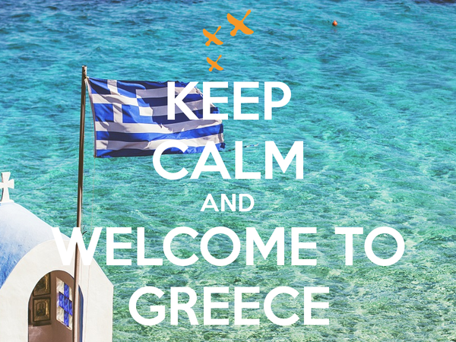
|
|
travelive.com

Slide 10
MOST COMMON PERCEPTIONS OF GREECE

Slide 11
FEEL #GREECE365 THE TRAVELIVE WAY

Slide 12
EXPERIENCES FOLLOWING THE PHILOSOPHY OF ΑΠΟΛΑΥΣΗ
Authentic and immersive itineraries on and off the beaten path
Combine the traditional side of Greece with exclusive accommodations including villas and yachts
Non-googleable experiences
Luxury redefined centering around self-actualization and desire to uncover new things
Itineraries centered around client’s interests and passions
|
|
travelive.com

Slide 13
(Discover)

Slide 14
DIRECT SERVICE FROM USA TO ATHENS
New seasonal service from ORD
Seasonal service from PHL
Seasonal service from JFK
Seasonal service from JFK
Year-round service from EWR
Seasonal service from EWR
|
|
travelive.com

Slide 15
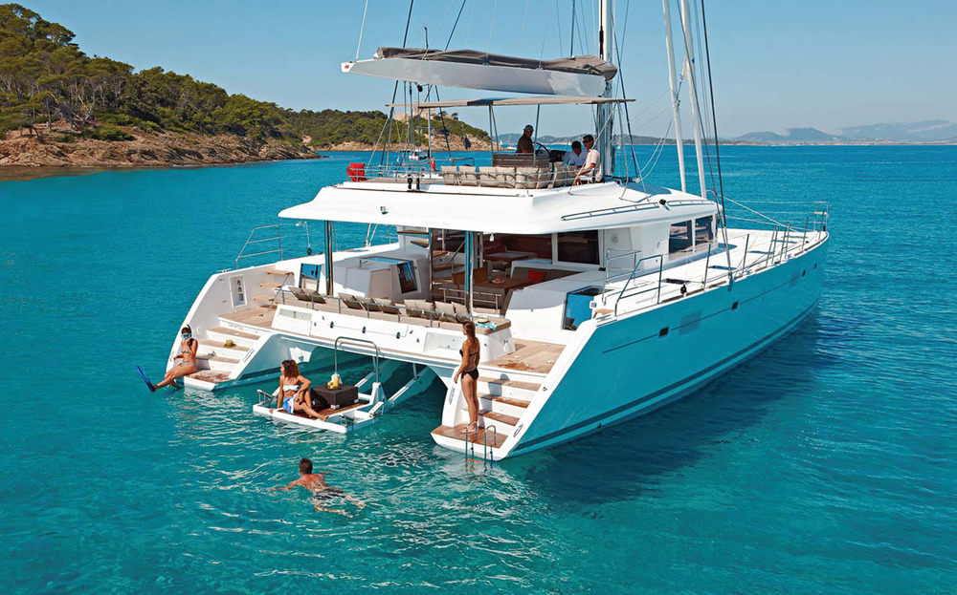
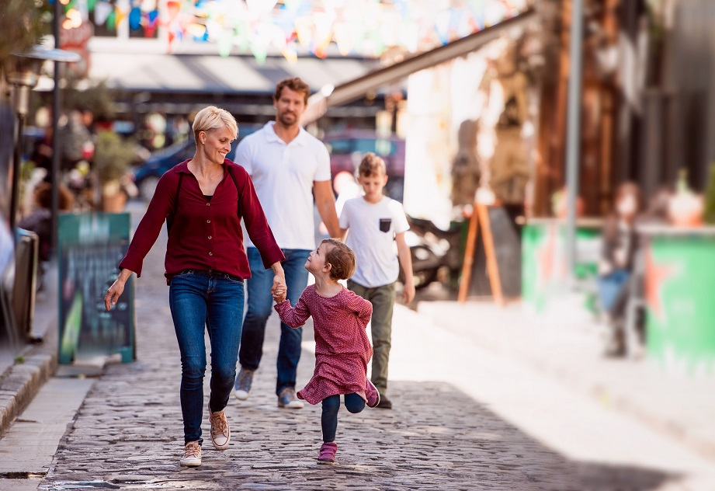
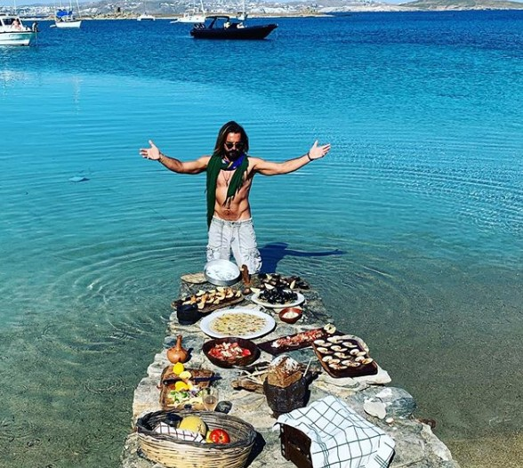
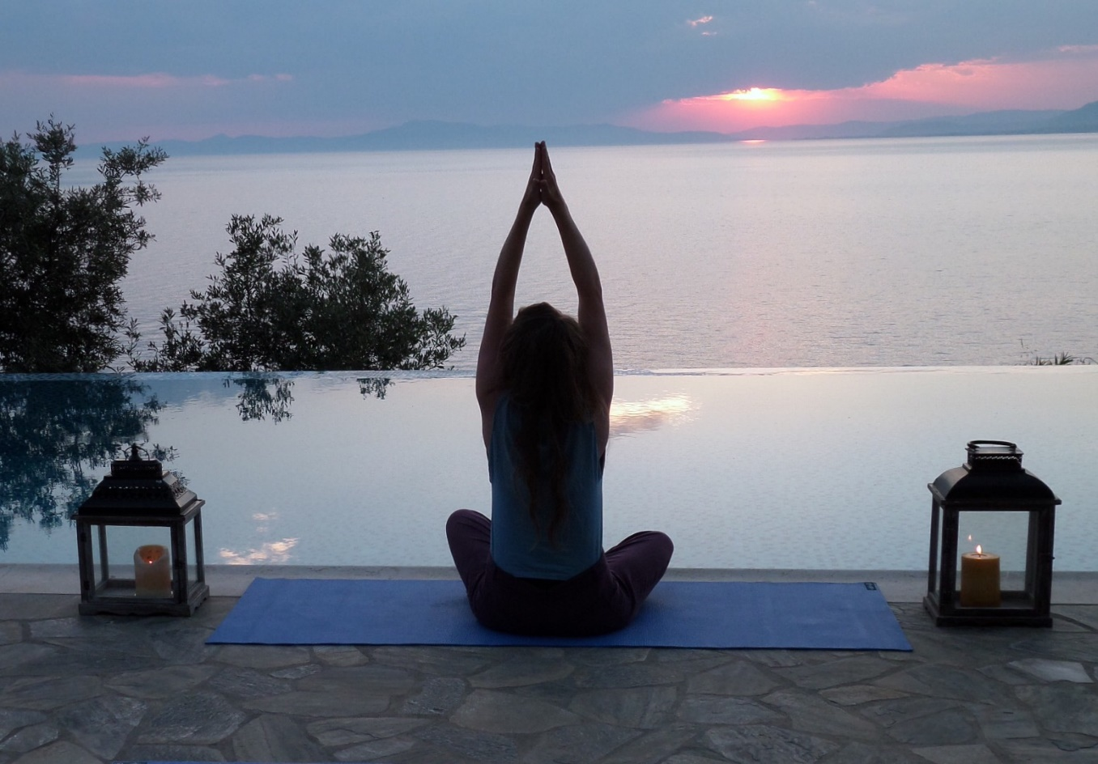
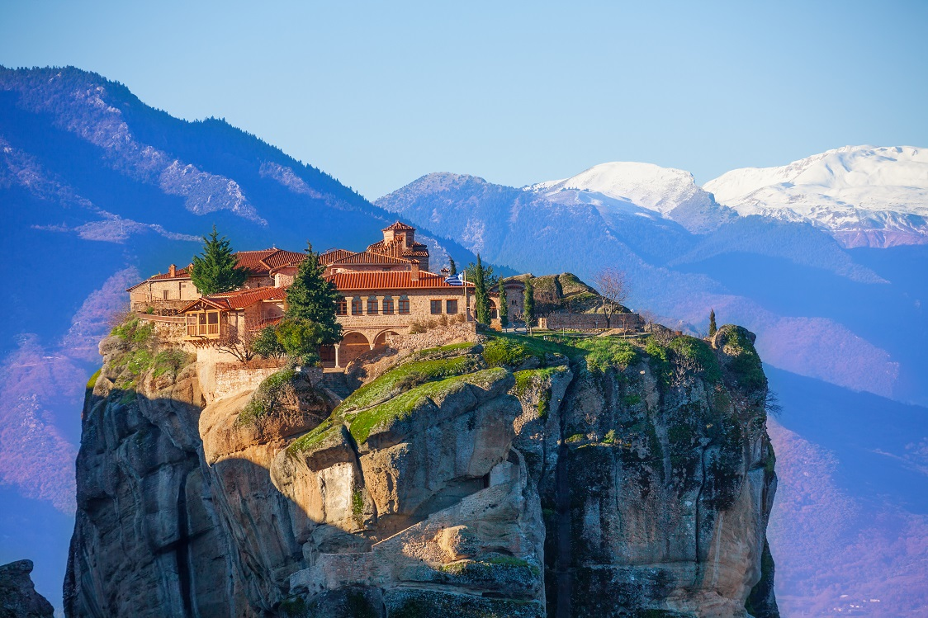
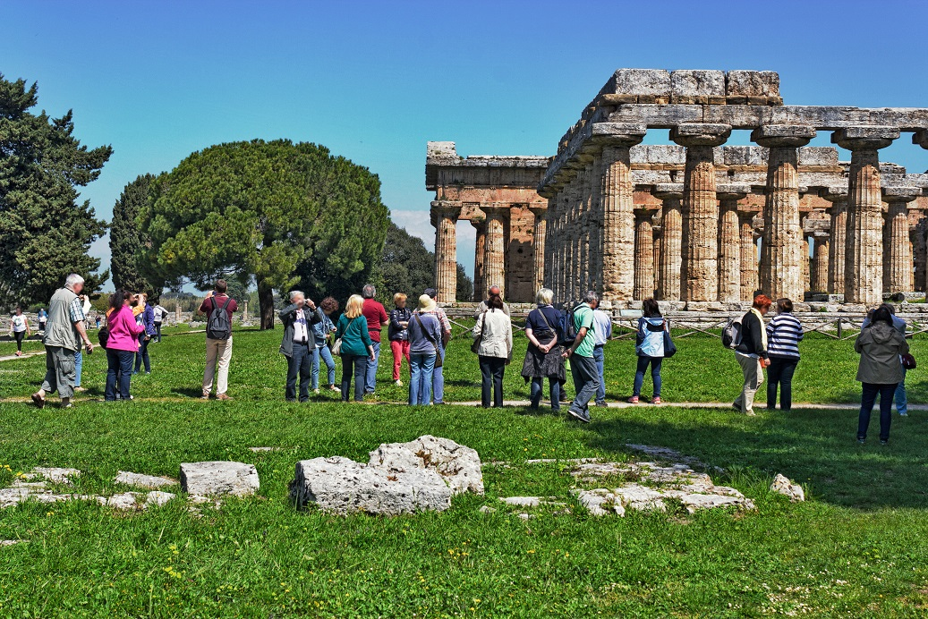
NEW TRENDS AND DESTINATIONS FOR 2020
Lifestyle Cooking
Catamarans
Family and multi-gen travel
Transformational experiences
Tailor made itineraries for groups
Off-season travel
|
|
travelive.com

Slide 16
A Greek Destination for Every Passion

Slide 17
REVIVAL OF ATHENS - no longer a transit destination
Athens
40
Athens International Airport
mins
Piraeus
30
mins
20
mins
Vouliagmeni
Featured Hotel: Four Seasons Astir Palace Hotel Athens
fourseasons.com

Slide 18
A STRING OF CAPITAL PROJECTS IS SET TO TRASNSFORM THE FACE OF THE 43-MILE-LONG ATHENS RIVIERA
8 bn EURO investment turning former Athens airport at Ellinikon into a vast luxury complex
New luxury hotel within the Asteria complex in Glyfada
New and exciting properties within the Athens city center

Slide 19
CYCLADES
Portara, Naxos Island – Greece
|
|
travelive.com

Slide 20
CYCLADES
best months & ideal stay
May-October 7-14 days
combines well with
Crete, Northern Greece
FOLEGANDROS
for off-the-beaten path
IOS
for untouched beaches
MILOS for sailing MYKONOS for Jetset NAXOS for local culture PAROS – Mykonos as it once was
SANTORINI for romance
key destinations
Don’t limit yourself to the islands you’ve heard of, some of the lesser
known islands offer hidden surprises and quickly become client favorites. I suggest rib-boat day tours for unique island-hopping experiences
Mina’s Insider tip
|
|
travelive.com

Slide 21
MYKONOS – not just for party goers
Athens
Myconian Ambassador
3
hrs
35
mins
Mykonos
Little Venice
|
|
travelive.com

Slide 22
SANTORINI – go beyond the Caldera
Athens
Canaves Oia Epitome
45
mins
5
hrs
Santorini
Wine Tasting
|
|
travelive.com

Slide 23
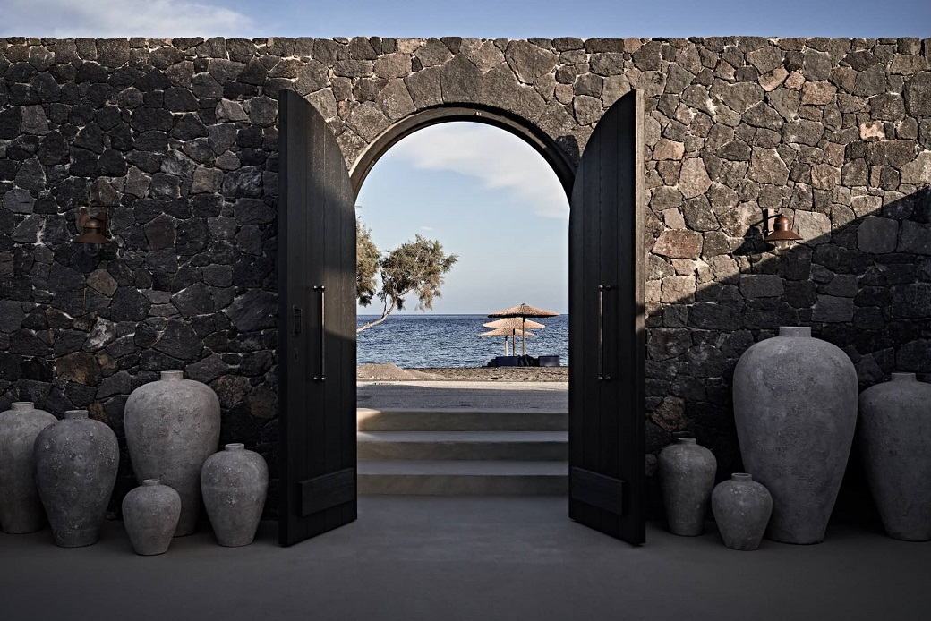
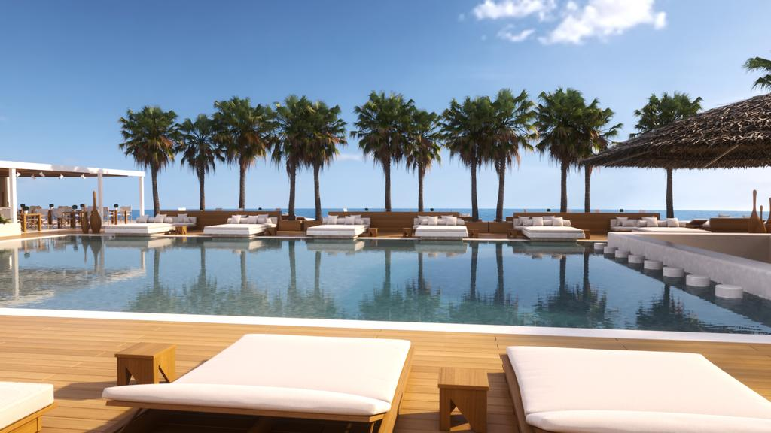
NEW! SANTORINI AS A BEACH DESTINATION
Athens
Athens
45
mins
5
hrs
Santorini
Featured Hotels: Istoria & Nikki Beach

Slide 24
NAXOS – Green oasis in the Cyclades
Athens
18 Grapes Hotel
3.5
hrs
40
mins
Naxos
Graviera Cheese
|
|
travelive.com

Slide 25
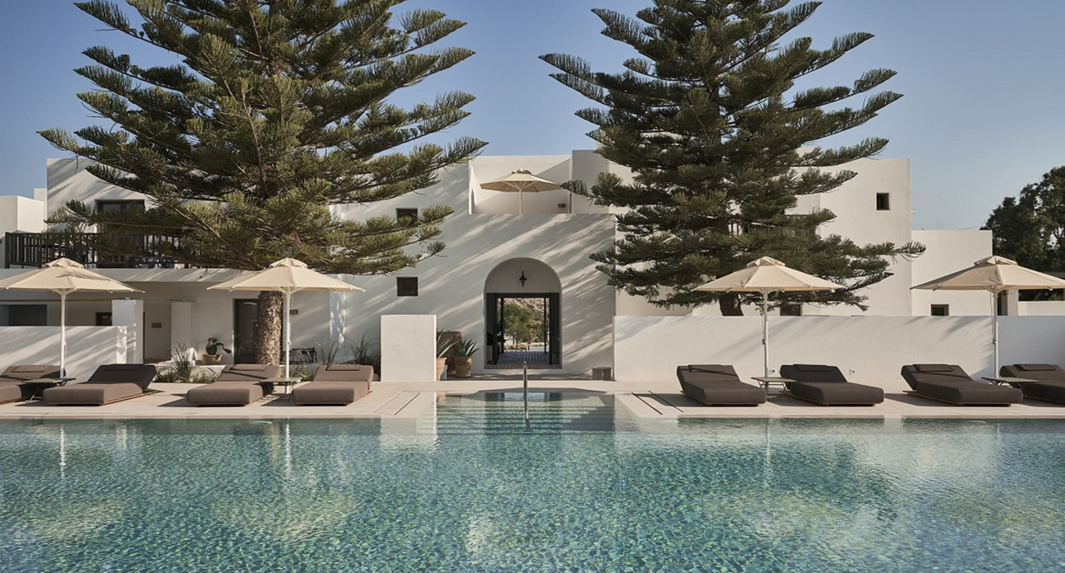
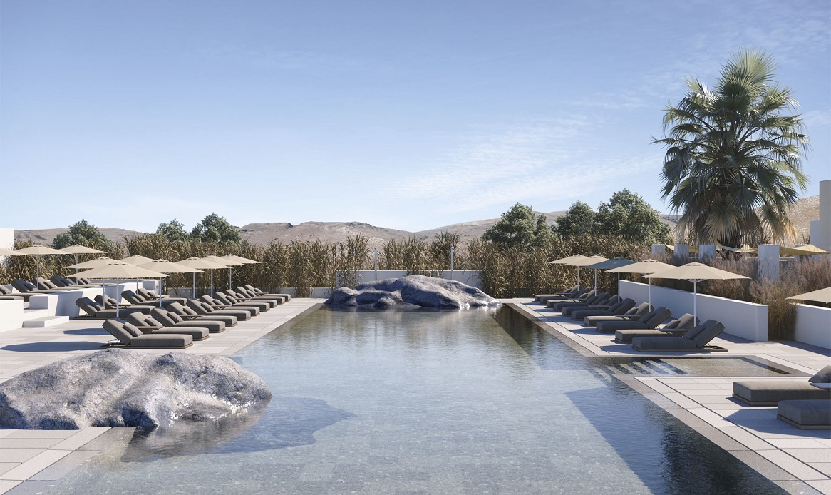
PAROS – Authentic Cyclades paired with exquisite accommodation
Athens
4
hrs
Paros
Featured Hotel: Parilio Hotel
pariliohotelparos.com
|
|
travelive.com

Slide 26
MILOS – Sailing paradise
Athens
Melian Boutique Hotel & Spa
3
hrs
40
mins
Milos
Kleftiko Bay
|
|
travelive.com

Slide 27
FOLEGANDROS – Santorini without the crowds
Athens
Anemi Hotel
4
hrs
Folegandros
40
mins
Santorini
Off-the-beaten-path island
|
|
travelive.com

Slide 28
IOS for pristine beaches
Athens
Ios Liostasi
5
hrs
Ios
40
mins
Santorini
Ios beach
|
|
travelive.com

Slide 29
CRETE
Elounda, Crete – Greece
|
|
travelive.com

Slide 30
CRETE – 4 regions – thousands of experiences
best months & ideal stay
All year 4-8 days
combines well with
Cyclades, Dodecanese, Ionian
AGIOS NIKOLAOS
for local fishing town
CHANIA for local culture
ELOUNDA for luxury beach resorts
KNOSSOS for classical Minoan Palace
LASITHI REGION
for traditional villages
RETHYMNO for charming old town
SAMARIA GORGE
for hiking
key destinations
Explore Crete’s local food, olive oil, wine and spirits or go completely off the radar to traditional villages
like Sfakia and Loutro.
Mina’s Insider tip
|
|
travelive.com

Slide 31
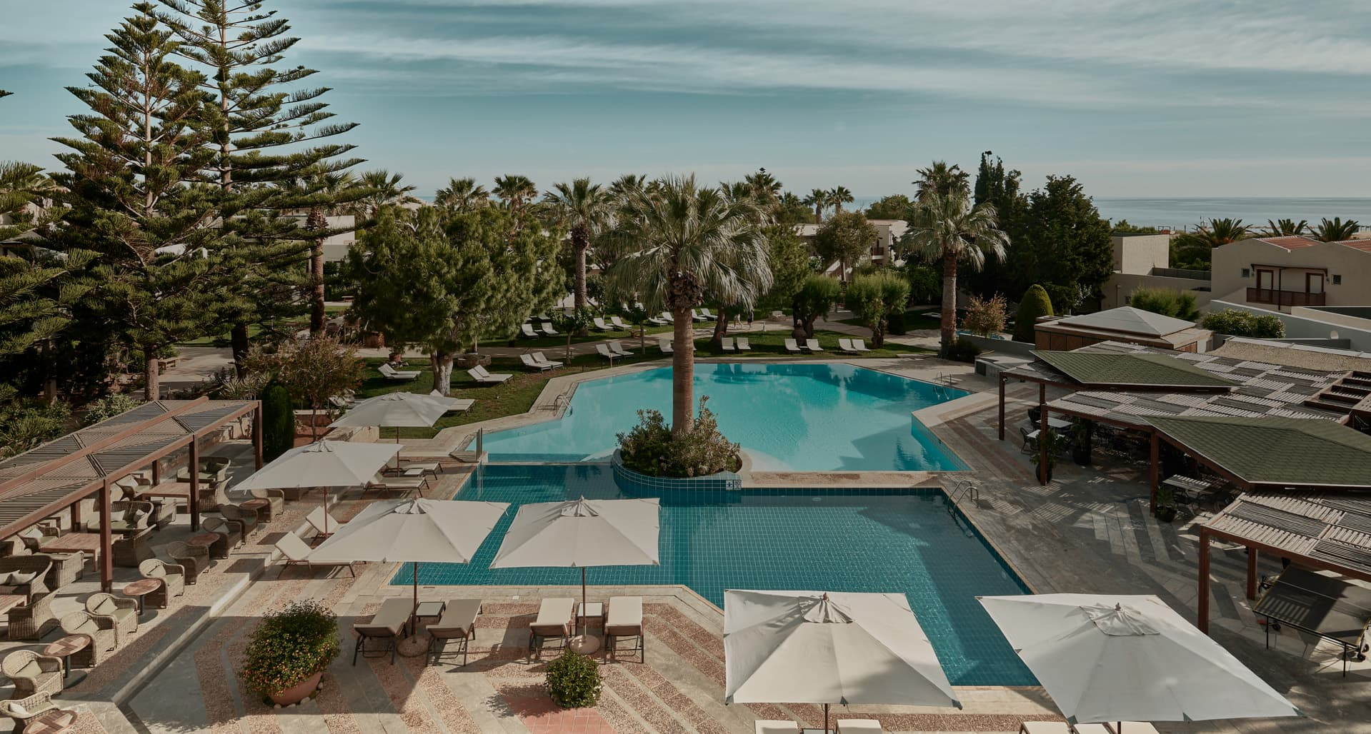
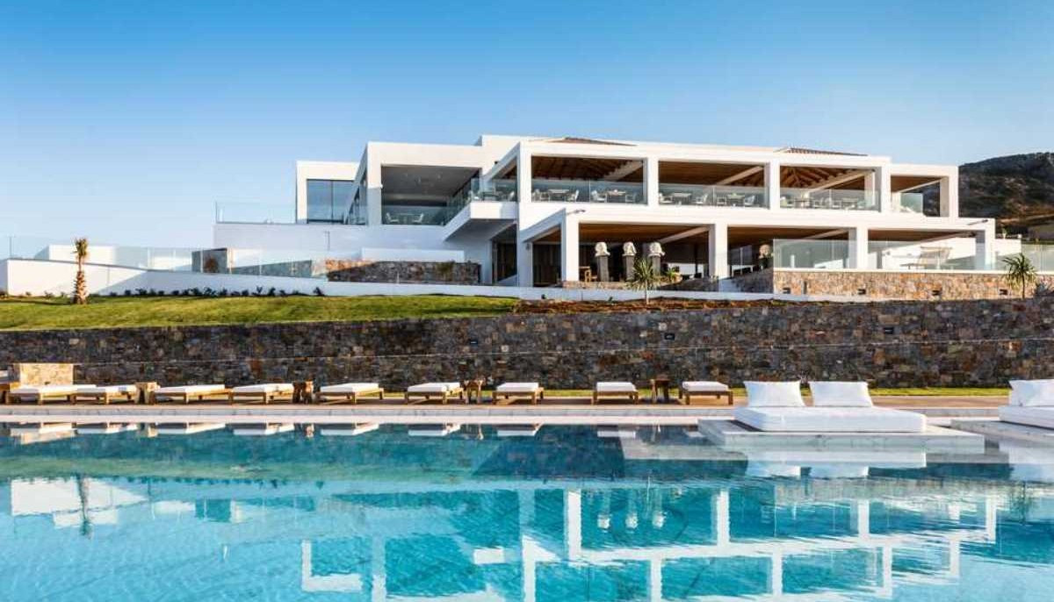
CRETE New Properties
Cretan Malia Park
Abaton

Slide 32
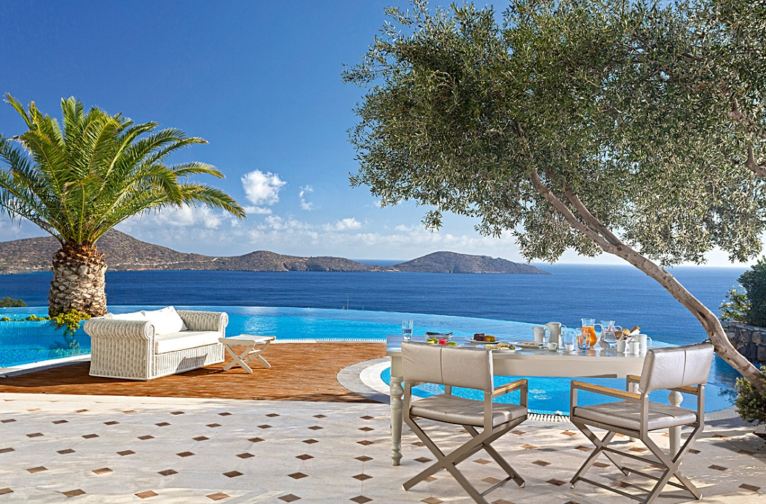
CRETE
Athens
Elounda Gulf Villas, Elounda
50
mins
55
mins
5hrs
Chania
Heraklion
Elounda
6
Crete
hrs
Casa Delfino Hotel & Spa, Chania
|
|
travelive.com

Slide 33
CRETAN FILOXENIA
Chania old port
Family fun at Knossos Palace
Samaria Gorge hiking
Lasithi Region – village cooking
|
|
travelive.com

Slide 34
IONIAN
Navagio Beach, Zakynthos Island - Greece
|
|
travelive.com

Slide 35
IONIAN
best months & ideal stay
May-October 7-10 days
combines well with
Crete, Peloponnese
CORFU
for multi-cultural heritage
ITHAKA
for Homer’s mythical Odyssey
KEFALONIA
for blue-green harmony
LEFKADA
for its culinary mosaic
PAXOS
for crystal clear waters
ZAKYNTHOS for blue caves
key destinations
With new ferry service connecting these islands, exciting Ionian combinations are now available.
Also, consider the Ionian for private yacht charters, as the sea conditions
are ideal.
Mina’s Insider tip
|
|
travelive.com

Slide 36
CORFU
Corfu
1hr
Corfu Imperial Grecotel
Athens
Multi-cultural island
|
|
travelive.com

Slide 37
KEFALONIA
Kefalonia Grand Hotel
55
mins
Kefalonia
Athens
Blue-green harmony
|
|
travelive.com

Slide 38
ZAKYNTHOS
Porto Zante Villas & Spa
50
mins
Athens
Zakynthos
Blue Caves
|
|
travelive.com

Slide 39
SARONIC – Hop skip and a wink from Athens
Aegina Island - Greece
|
|
travelive.com

Slide 40
SARONIC
best months & ideal stay
April-October 3-7 days
combines well with
Peloponnese
AEGINA for the famous Afea Temple
AGISTRI for birding
HYDRA for peaceful, pedestrian only relaxation
METHANA for stunning volcanic landscape
POROS for its lively harbor
SPETSES for exclusive neo-classical splendor
key destinations
The Saronic Islands offer an ideal base for exploring private coves, tiny villages, beach side tavernas and uninhabited islands
by private rib boat.
Mina’s Insider tip
|
|
travelive.com

Slide 41
SPETSES
Athens
Poseidonion Grand Hotel
2.5
hrs
Spetses
Neo-classical splendor
|
|
travelive.com

Slide 42
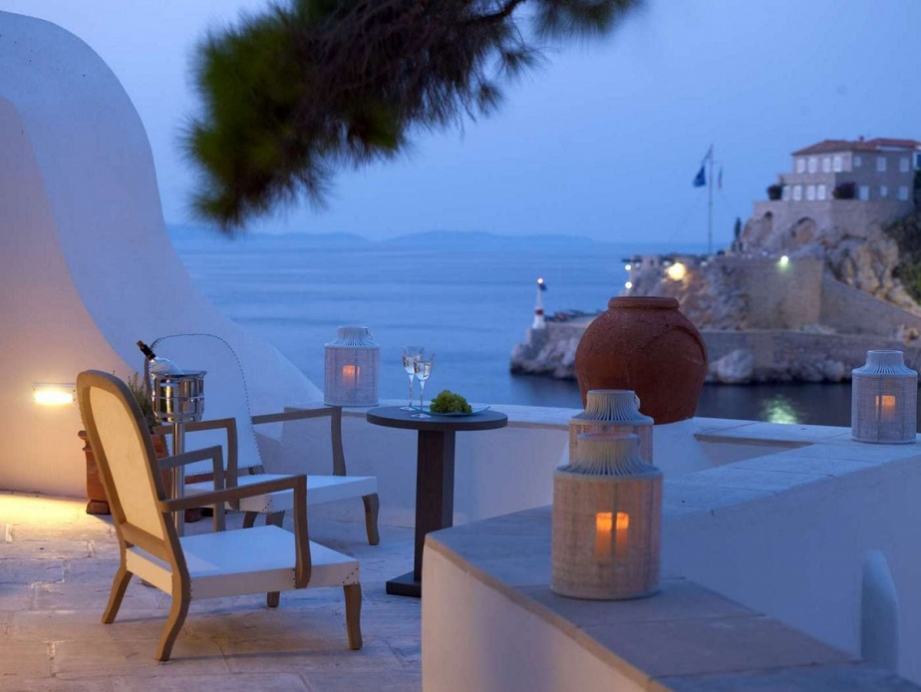
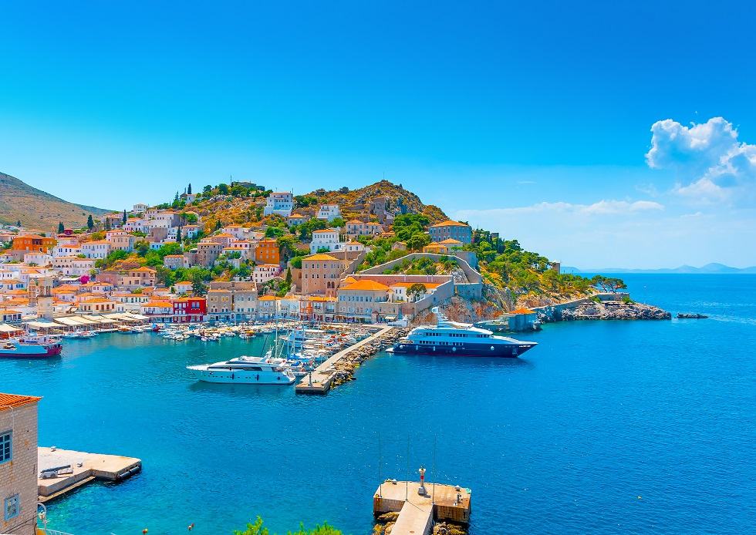
HYDRA
Athens
Hyrdea Hotel
2
hrs
Hydra
Hydra – No cars, only boats, donkeys and pristine nature
|
|
travelive.com

Slide 43
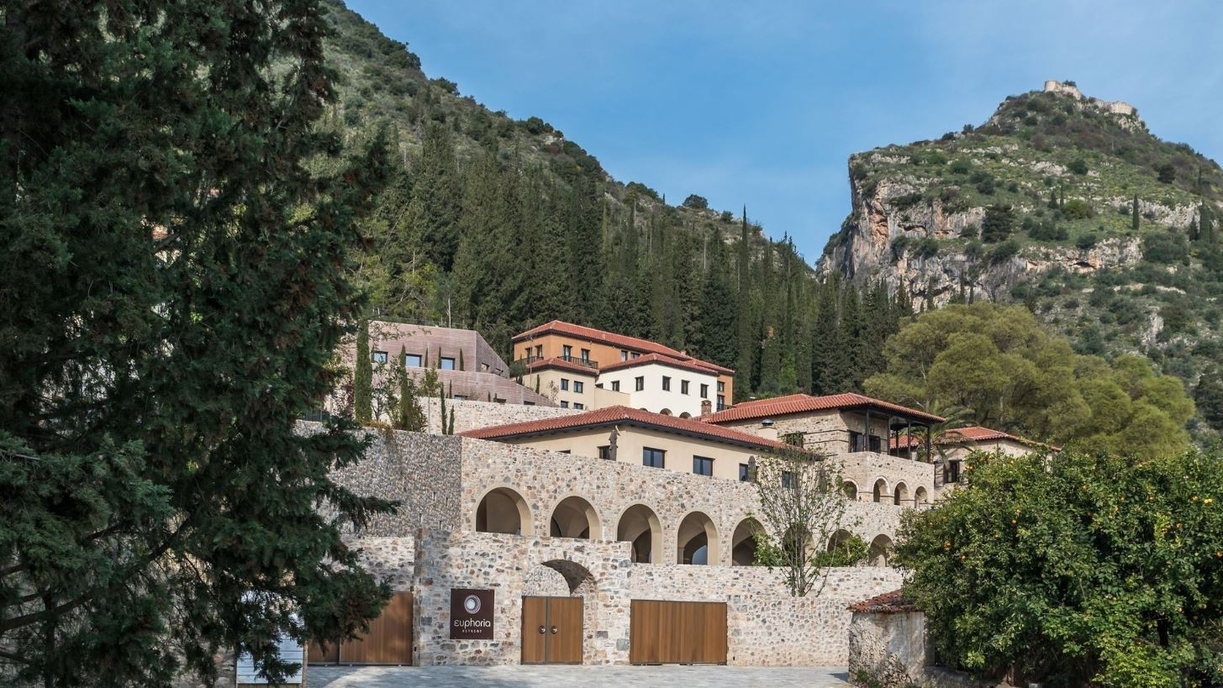
PELOPONNESE- The cradle of Wellness
Featured property – Euphoria Retreat Mystra
|
|
travelive.com

Slide 44
PELOPONNESE
Truly unique experiences created away from the crowds all year round
Destinations for foodies, oenophiles and nature lovers with farm to table philosophy
Holistic retreats and transformational experiences
Destination for true history buffs
Farms, olive groves, wineries, cheese makers…
As local and as immersive as Greece gets

Slide 45
PELOPONNESE
best months & ideal stay
All year 4-10 days
combines well with
Saronic, Ionian, Northern Greece
ANCIENT OLYMPIA
for the birthplace of the famous games
CORINTH for famous canal
MONEMVASIA for romantic Venetian Castle town
MYCENAE for ancient Greece’s golden city
NAFPLIO for charming seaside town
NEMEA for wineries
PORTO HELI for exclusive luxury resorts
PYLOS for outdoor enthusiasts
key destinations
Experience the most transformational experience by visiting Euphoria retreat
Mina’s Insider tip
|
|
travelive.com

Slide 46
CORINTH
Corinth
1hr
Athens
Corinth Canal
|
|
travelive.com

Slide 47
NEMEA – For Wine lovers
Athens
1.5
hrs
Nemea
Nemea wine roads
|
|
travelive.com

Slide 48
MYCENAE for history buffs
Athens
1.5
hrs
Mycenae
Mycenae – Lion Gate
|
|
travelive.com

Slide 49
NAFPLION for Romantics
Athens
2
hrs
Nafplion
Nafplion – charming seaside
|
|
travelive.com

Slide 50
PORTO HELI
Athens
2.5
hrs
Amanzoe
Porto Heli
Nafplion
|
|
travelive.com

Slide 51
MONEMVASIA – Farm to Table dining
Athens
4
hrs
Kinsterna Hotel
Monemvasia
Monemvasia island
|
|
travelive.com

Slide 52
EUPHORIA RETREAT – MYSTRAS Fully Holistic Wellness Resort
Athens
3
hrs
Mystras
Featured Hotel: Euphoria Retreat
euphoriaretreat.com

Slide 53
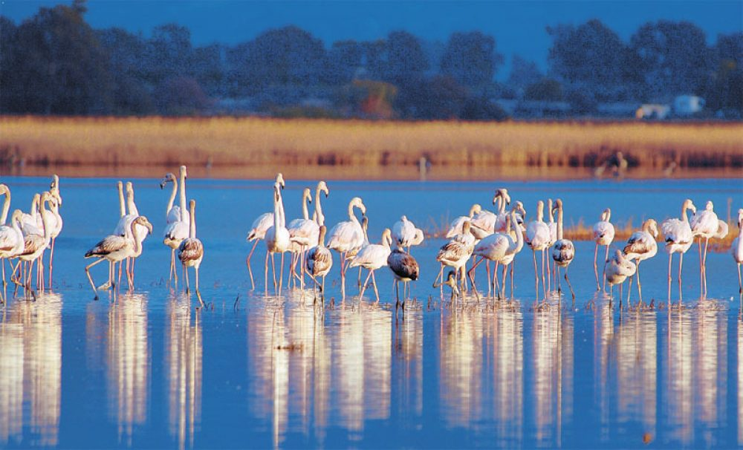
PYLOS – Combination of luxury retreats and immersive tours
Athens
3.5
hrs
The Romanos, Luxury Collection
Pylos
Pink Flamingos in the Gialova Wetlands
|
|
travelive.com

Slide 54
OLYMPIA
Athens
3.5
hrs
Olympia
Birthplace of Olympic Games
|
|
travelive.com

Slide 55
NORTHERN GREECE – Spiritual experiences
Meteora Monasteries, Kalambaka – Greece
|
|
travelive.com

Slide 56
NORTHERN GREECE
best months & ideal stay
All year 4-10 days
combines well with
Peloponnese
CHALKIDIKI
for luxury beach resorts
KAVALA for Greece’s latest UNESCO site
METEORA for religious heritage
THESSALONIKI
for art and culture
VERGINA
for Alexander the Great
ZAGORIA for hiking
key destinations
Provoking itineraries are available year-round to Northern Greece’s many UNESCO World Heritage Sites.
Mina’s Insider tip
|
|
travelive.com

Slide 57
THESSALONIKI
Thessaloniki
55
Electra Palace Thessaloniki
mins
Athens
Thessaloniki – Art & Culture
|
|
travelive.com

Slide 58
CHALKIDIKI
Thessaloniki
50
mins
Chalkidiki
55
Sani Asterias
mins
Athens
Sani Asterias Beach
|
|
travelive.com

Slide 59
KAVALA
Kavala
55
mins
Athens
Kavala – Ancient Site of Philippi
|
|
travelive.com

Slide 60
VERGINA
1
Thessaloniki
Vergina
hrs
55
mins
Athens
Tomb of King Philip, Alexander the Great’s father
|
|
travelive.com

Slide 61
ZAGORIA
Zagoria
1.5
hrs
Ioannina
55
mins
Athens
Zagoria – hiking
|
|
travelive.com

Slide 62
METEORA
Meteora
4
hrs
Athens
Meteora - Religious heritage
|
|
travelive.com

Slide 63
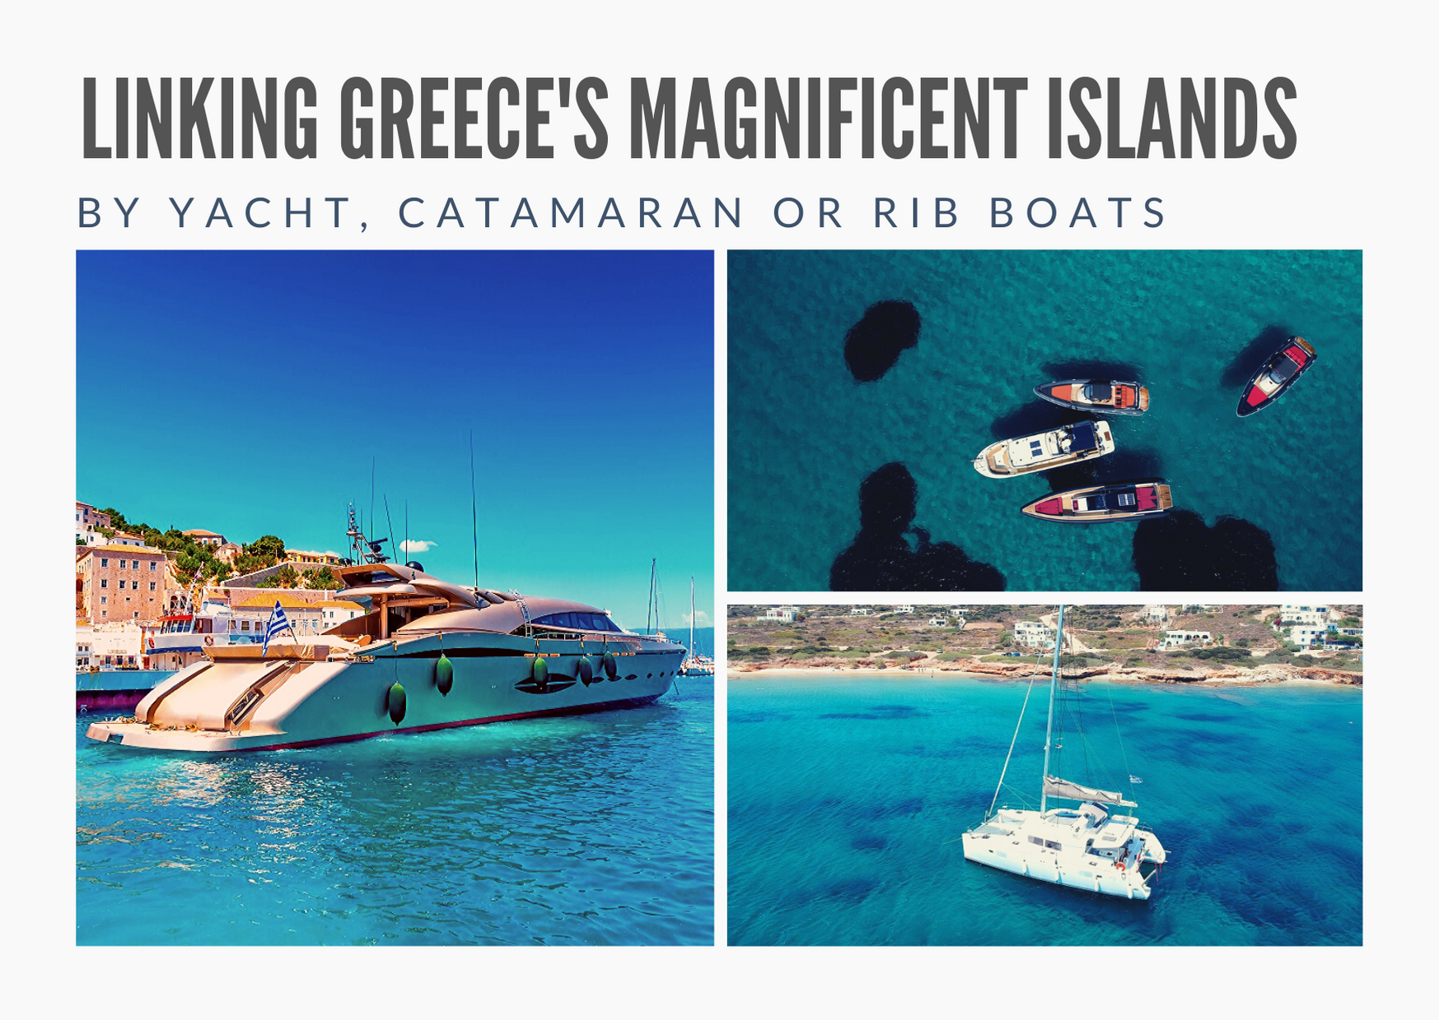
ΘΑΛΑΣΣΑ − Discover Greece by Sea
Linking Greece’s Magnificent Islands
with Rib Boats, Catamarans and
& Yacht Charters
|
|
travelive.com

Slide 64
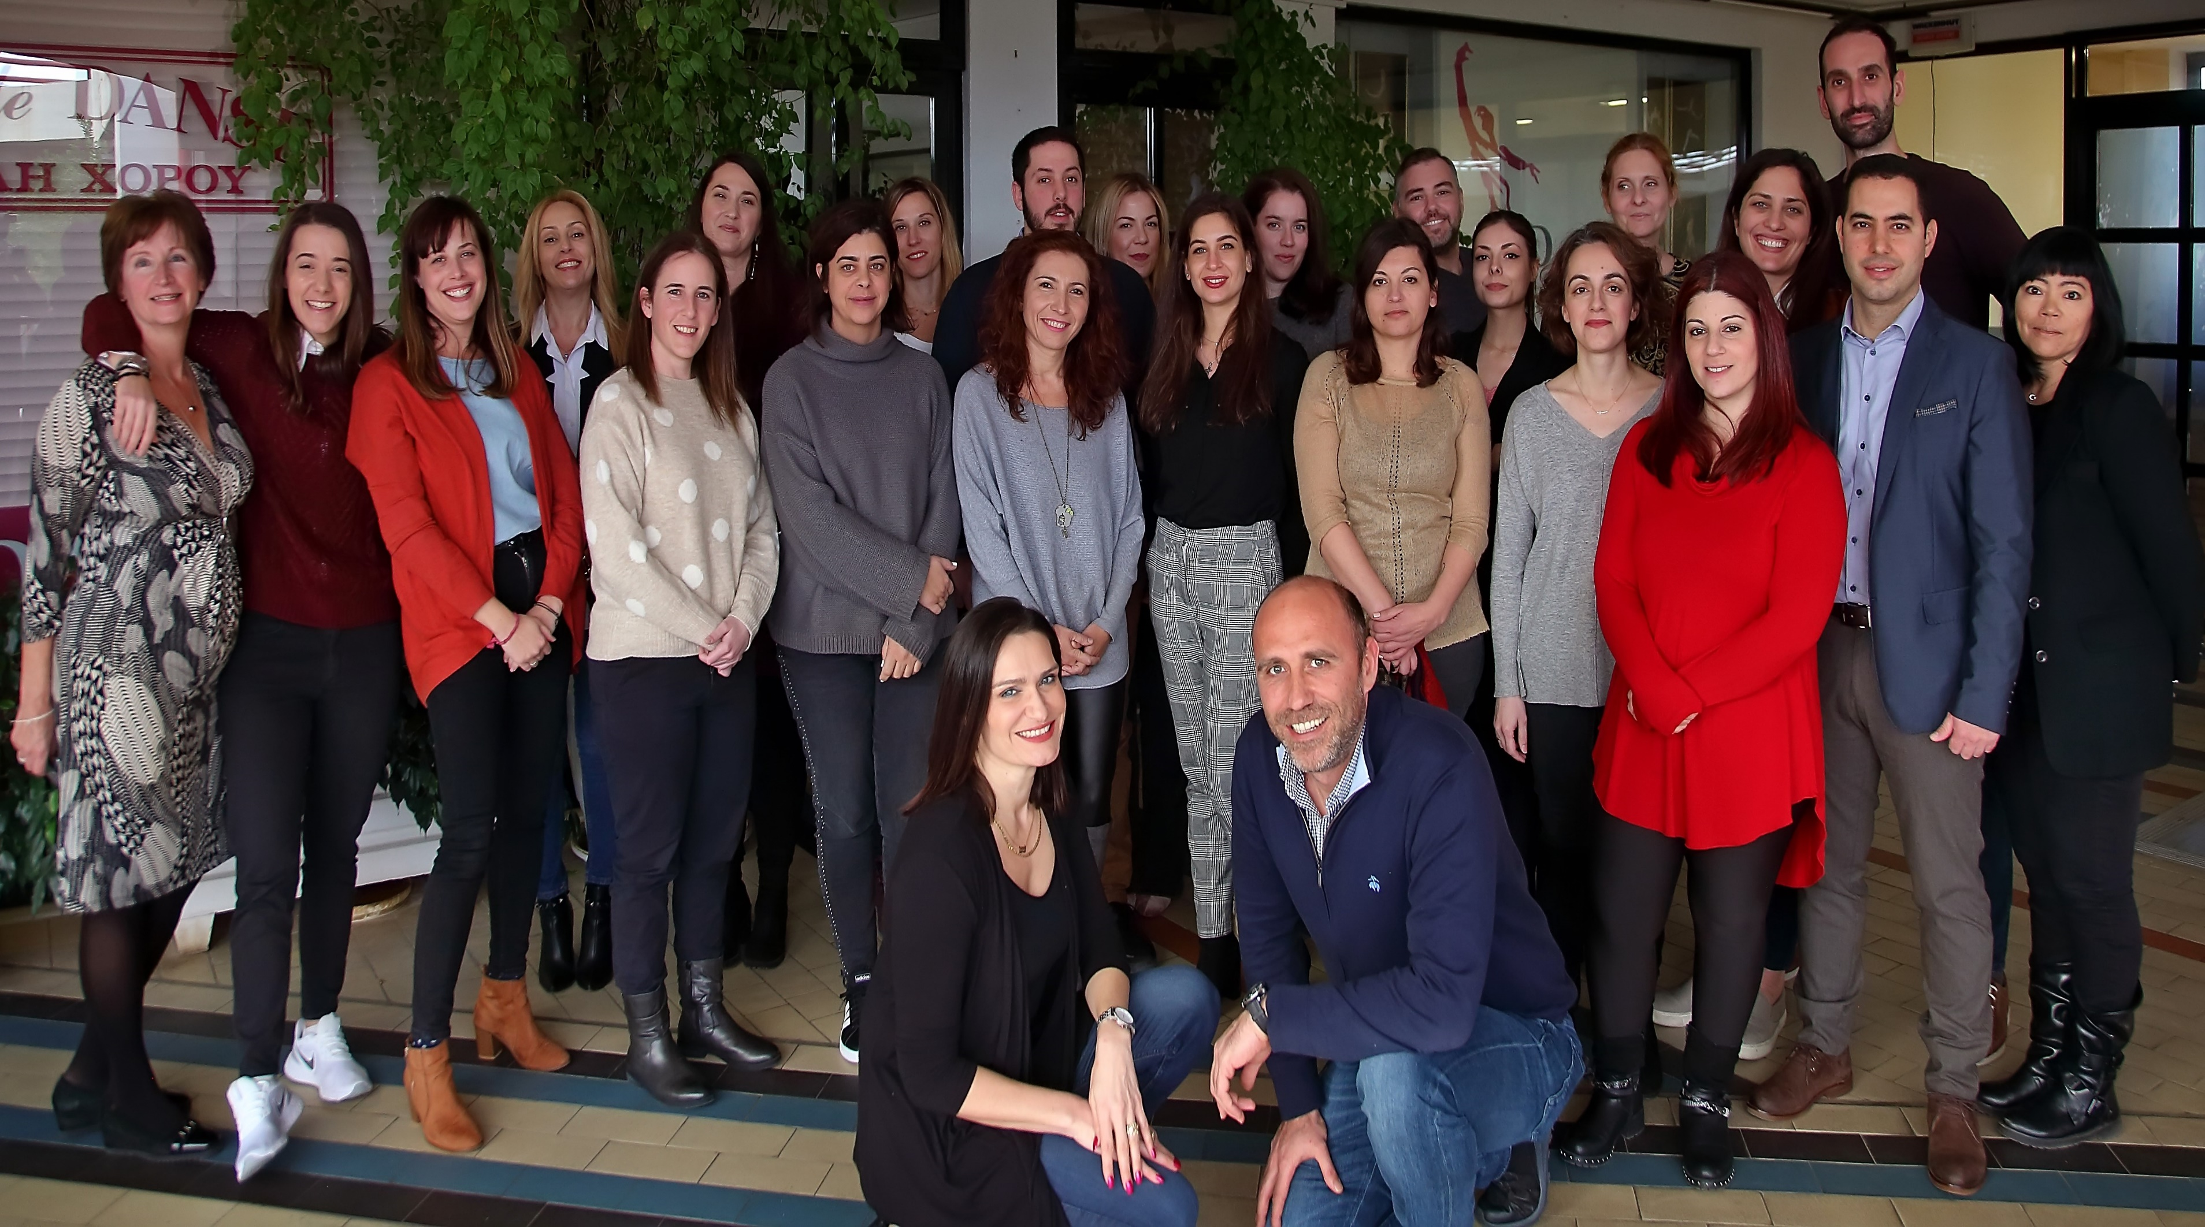
Γεια σας from your trusted team @ Travelive
|
|
travelive.com

Slide 65
Ευχαριστώ!!!
priority@travelive.com www.travelive.com
888.377.LIVE (5483)
facebook.com/Travelive instagram.com/travelivecom
|
|
travelive.com

